Slide 1
Component-based software engineering

Slide 2
Objectives
To explain that CBSE is concerned with developing standardised components and composing these into applications
To describe components and component models
To show the principal activities in the CBSE process
To discuss approaches to component composition and problems that may arise

Slide 3
Topics covered
Components and component models
The CBSE process
Component composition

Slide 4
Component-based development
Component-based software engineering (CBSE) is an approach to software development that relies on software reuse.
It emerged from the failure of object-oriented development to support effective reuse. Single object classes are too detailed and specific.
Components are more abstract than object classes and can be considered to be stand-alone service providers.

Slide 5
CBSE essentials
Independent components specified by their interfaces.
Component standards to facilitate component integration.
Middleware that provides support for component inter-operability.
A development process that is geared to reuse.

Slide 6
CBSE and design principles
Apart from the benefits of reuse, CBSE is based on sound software engineering design principles:
  Components are independent so do not interfere with each other;
  Component implementations are hidden;
  Communication is through well-defined interfaces;
  Component platforms are shared and reduce development costs.

Slide 7
CBSE problems
Component trustworthiness - how can a component with no available source code be trusted?
Component certification - who will certify the quality of components?
Emergent property prediction - how can the emergent properties of component compositions be predicted?
Requirements trade-offs - how do we do trade-off analysis between the features of one component and another?

Slide 8
Components
Components provide a service without regard to where the component is executing or its programming language
  A component is an independent executable entity that can be made up of one or more executable objects;
  The component interface is published and all interactions are through the published interface;

Slide 9
Component definitions
Councill and Heinmann:
  A software component is a software element that conforms to a component model and can be independently deployed and composed without modification according to a composition standard.
Szyperski:
  A software component is a unit of composition with contractually specified interfaces and explicit context dependencies only. A software component can be deployed independently and is subject to composition by third-parties.

Slide 10
Component as a service provider
The component is an independent, executable entity. It does not have to be compiled before it is used with other components.
The services offered by a component are made available through an interface and all component interactions take place through that interface.

Slide 11
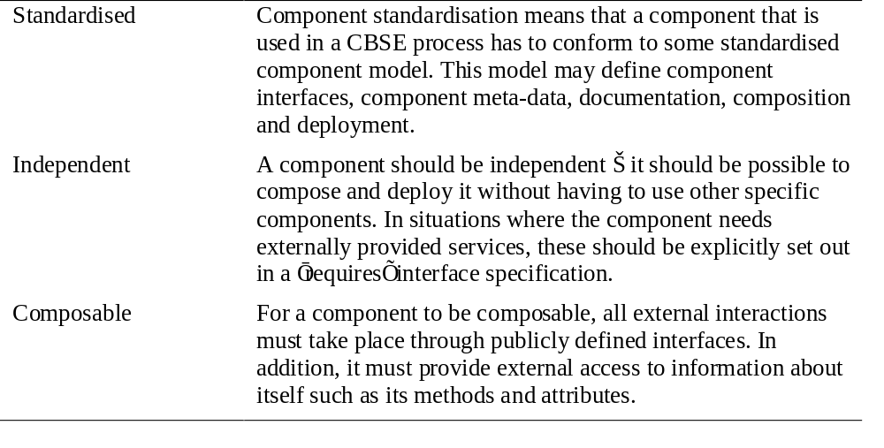
Component characteristics 1

Slide 12
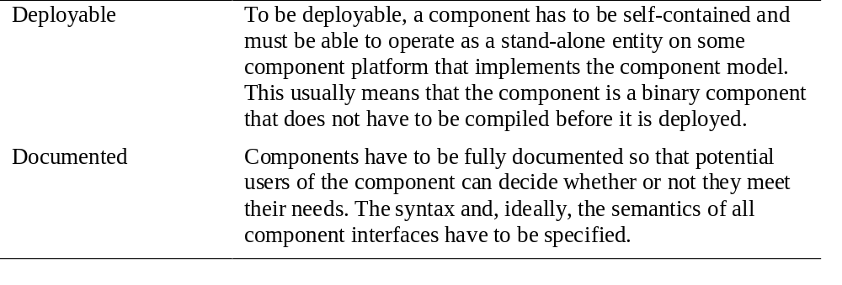
Component characteristics 2

Slide 13
Component interfaces
Provides interface
  Defines the services that are provided by the component to other components.
Requires interface
  Defines the services that specifies what services must be made available for the component to execute as specified.

Slide 14
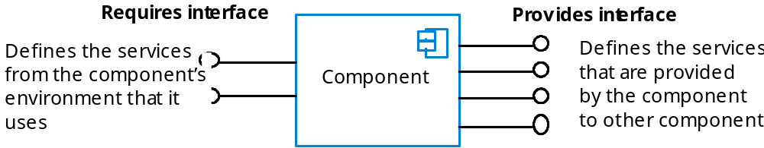
Component interfaces

Slide 15
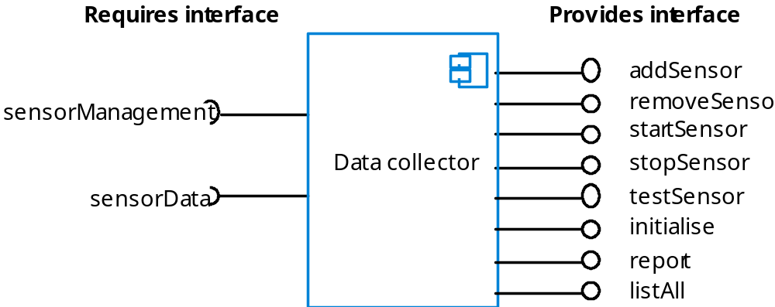
A data collector component

Slide 16
Components and objects
Components are deployable entities.
Components do not define types.
Component implementations are opaque.
Components are language-independent.
Components are standardised.

Slide 17
Component models
A component model is a definition of standards for component implementation, documentation and deployment.
Examples of component models
  EJB model (Enterprise Java Beans)
  COM+ model (.NET model)
  Corba Component Model
The component model specifies how interfaces should be defined and the elements that should be included in an interface definition.

Slide 18
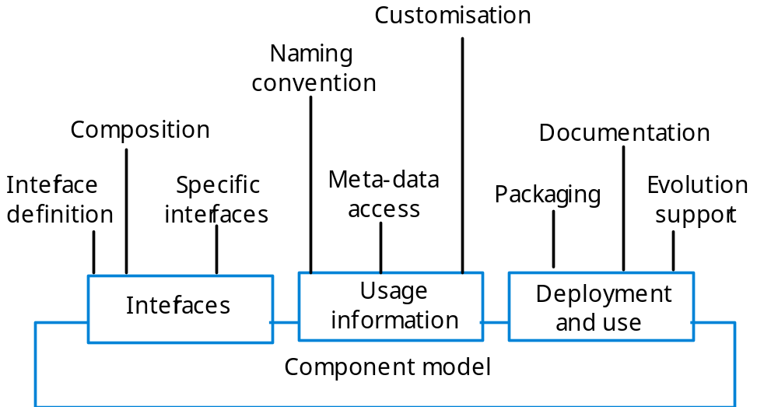
Elements of a component model

Slide 19
Middleware support
Component models are the basis for middleware that provides support for executing components.
Component model implementations provide:
  Platform services that allow components written according to the model to communicate;
  Horizontal services that are application-independent services used by different components.
To use services provided by a model, components are deployed in a container. This is a set of interfaces used to access the service implementations.

Slide 20
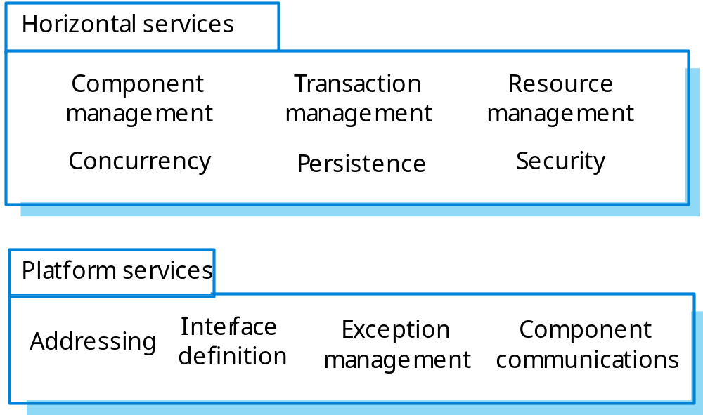
Component model services

Slide 21
Component development for reuse
Components developed for a specific application usually have to be generalised to make them reusable.
A component is most likely to be reusable if it associated with a stable domain abstraction (business object).
For example, in a hospital stable domain abstractions are associated with the fundamental purpose - nurses, patients, treatments, etc.

Slide 22
Component development for reuse
Components for reuse may be specially constructed by generalising existing components.
Component reusability
  Should reflect stable domain abstractions;
  Should hide state representation;
  Should be as independent as possible;
  Should publish exceptions through the component interface.
There is a trade-off between reusability and usability
  The more general the interface, the greater the reusability but it is then more complex and hence less usable.

Slide 23
Changes for reusability
Remove application-specific methods.
Change names to make them general.
Add methods to broaden coverage.
Make exception handling consistent.
Add a configuration interface for component adaptation.
Integrate required components to reduce dependencies.

Slide 24
Legacy system components
Existing legacy systems that fulfil a useful business function can be re-packaged as components for reuse.
This involves writing a wrapper component that implements provides and requires interfaces then accesses the legacy system.
Although costly, this can be much less expensive than rewriting the legacy system.

Slide 25
Reusable components
The development cost of reusable components may be higher than the cost of specific equivalents. This extra reusability enhancement cost should be an organization rather than a project cost.
Generic components may be less
space-efficient and may have longer execution times than their specific equivalents.

Slide 26
The CBSE process
When reusing components, it is essential to make trade-offs between ideal requirements and the services actually provided by available components.
This involves:
  Developing outline requirements;
  Searching for components then modifying requirements according to available functionality.
  Searching again to find if there are better components that meet the revised requirements.

Slide 27
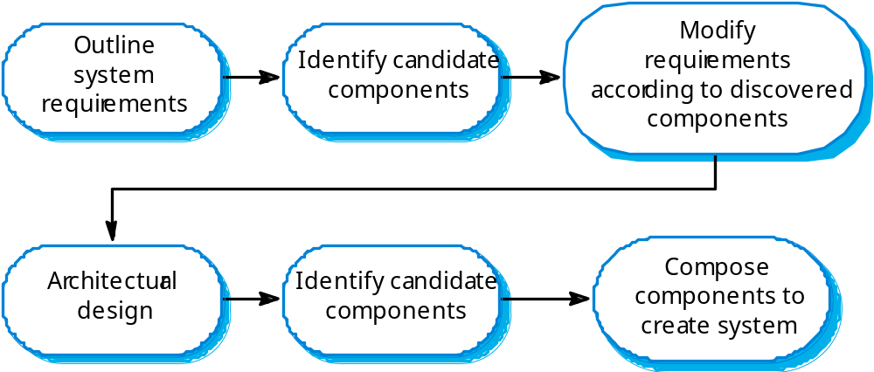
The CBSE process

Slide 28
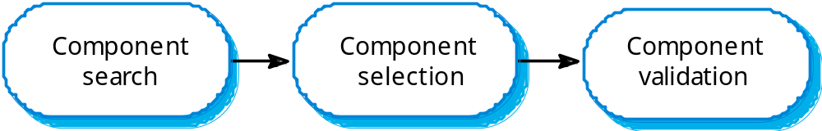
The component identification process

Slide 29
Component identification issues
Trust. You need to be able to trust the supplier of a component. At best, an untrusted component may not operate as advertised; at worst, it can breach your security.
Requirements. Different groups of components will satisfy different requirements.
Validation.
  The component specification may not be detailed enough to allow comprehensive tests to be developed.
  Components may have unwanted functionality. How can you test this will not interfere with your application?

Slide 30
Ariane launcher failure
In 1996, the 1st test flight of the Ariane 5 rocket ended in disaster when the launcher went out of control 37 seconds after take off.
The problem was due to a reused component from a previous version of the launcher (the Inertial Navigation System) that failed because assumptions made when that component was developed did not hold for Ariane 5.
The functionality that failed in this component was not required in Ariane 5.

Slide 31
Component composition
The process of assembling components to create a system.
Composition involves integrating components with each other and with the component infrastructure.
Normally you have to write ‘glue code’ to integrate components.

Slide 32
Types of composition
Sequential composition where the composed components are executed in sequence. This involves composing the provides interfaces of each component.
Hierarchical composition where one component calls on the services of another. The provides interface of one component is composed with the requires interface of another.
Additive composition where the interfaces of two components are put together to create a new component.

Slide 33
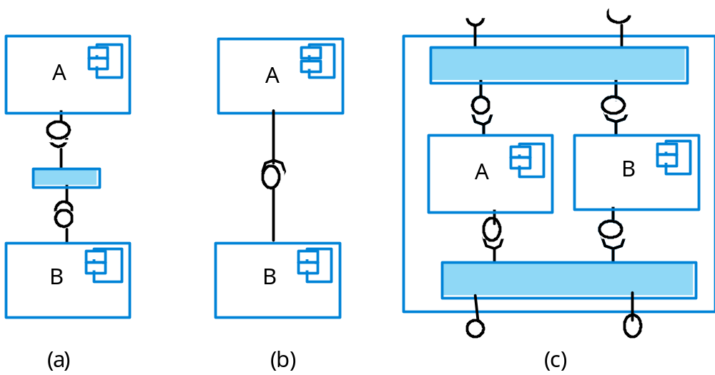
Types of composition

Slide 34
Interface incompatibility
Parameter incompatibility where operations have the same name but are of different types.
Operation incompatibility where the names of operations in the composed interfaces are different.
Operation incompleteness where the provides interface of one component is a subset of the requires interface of another.

Slide 35
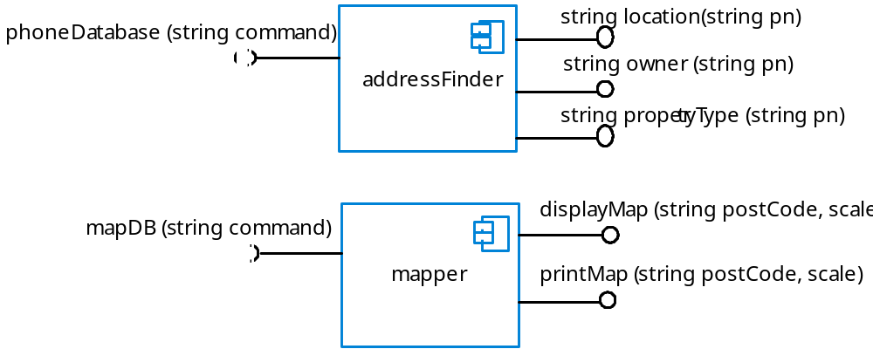
Incompatible components

Slide 36
Adaptor components
Address the problem of component incompatibility by reconciling the interfaces of the components that are composed.
Different types of adaptor are required depending on the type of composition.
An addressFinder and a mapper component may be composed through an adaptor that strips the postal code from an address and passes this to the mapper component.

Slide 37

Composition through an adaptor
The component postCodeStripper is the adaptor that facilitates the sequential composition of addressFinder and mapper components.

Slide 38
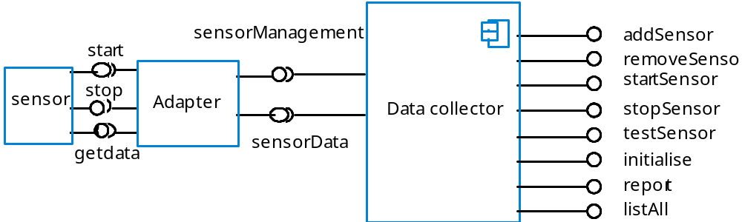
Adaptor for data collector

Slide 39

Interface semantics
You have to rely on component documentation to decide if interfaces that are syntactically compatible are actually compatible.
Consider an interface for a PhotoLibrary component:

Slide 40
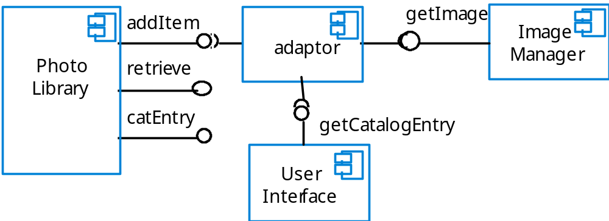
Photo library composition

Slide 41
Photo Library documentation
“This method adds a photograph to the library and associates the photograph identifier and catalogue descriptor with the photograph.”
“what happens if the photograph identifier is already associated with a photograph in the library?”
“is the photograph descriptor associated with the catalogue entry as well as the photograph i.e. if I delete the photograph, do I also delete the catalogue information?”

Slide 42
The Object Constraint Language
The Object Constraint Language (OCL) has been designed to define constraints that are associated with UML models.
It is based around the notion of pre and post condition specification - similar to the approach used in Z as described in Chapter 10.

Slide 43
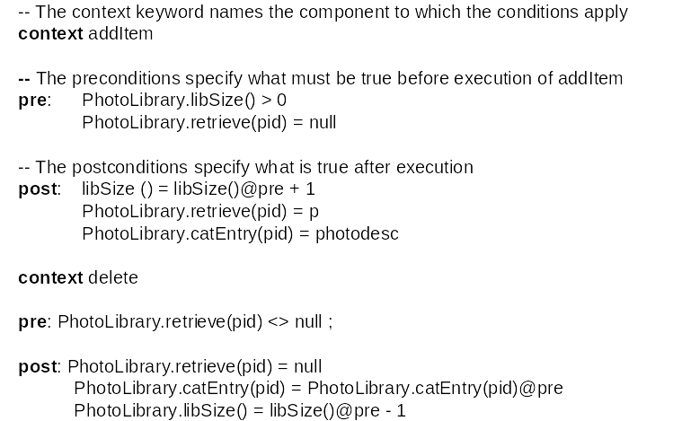
Formal description of photo library

Slide 44
Photo library conditions
As specified, the OCL associated with the Photo Library component states that:
  There must not be a photograph in the library with the same identifier as the photograph to be entered;
  The library must exist - assume that creating a library adds a single item to it;
  Each new entry increases the size of the library by 1;
  If you retrieve using the same identifier then you get back the photo that you added;
  If you look up the catalogue using that identifier, then you get back the catalogue entry that you made.

Slide 45
Composition trade-offs
When composing components, you may find conflicts between functional and non-functional requirements, and conflicts between the need for rapid delivery and system evolution.
You need to make decisions such as:
  What composition of components is effective for delivering the functional requirements?
  What composition of components allows for future change?
  What will be the emergent properties of the composed system?

Slide 46
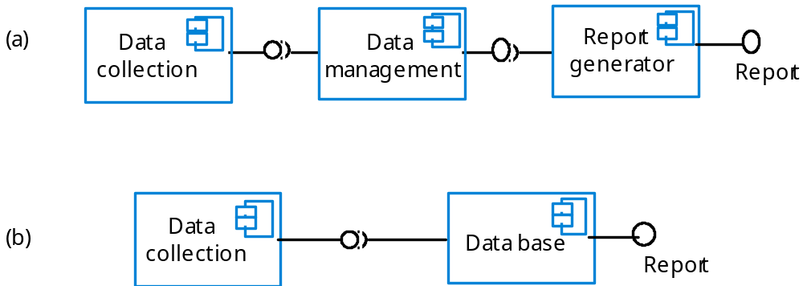
Data collection and report generation

Slide 47
Key points
CBSE is a reuse-based approach to defining and implementing loosely coupled components into systems.
A component is a software unit whose functionality and dependencies are completely defined by its interfaces.
A component model defines a set of standards that component providers and composers should follow.
During the CBSE process, the processes of requirements engineering and system design are interleaved.

Slide 48
Key points
Component composition is the process of ‘wiring’ components together to create a system.
When composing reusable components, you normally have to write adaptors to reconcile different component interfaces.
When choosing compositions, you have to consider required functionality, non-functional requirements and system evolution.

